Slide 1





X
GEEK VERSE
GRADWISE
BTECH STUDENTS ARE UNDER CONSTANT ACADEMIC PRESSURE. ON TOP OF THAT, THEY’RE EXPECTED TO UPSKILL, BUILD PROJECTS, JOIN HACKATHONS, FIND INTERNSHIPS, AND CRAFT THE PERFECT RESUME — ALL WHILE JUMPING BETWEEN DOZENS OF SCATTERED PLATFORMS LIKE YOUTUBE, COURSERA, DEVFOLIO, LINKEDIN, AND MORE. IT’S OVERWHELMING, INEFFICIENT, AND FRUSTRATING.
DOMINATORS
YASH GOEL
ABES ENGINEERING COLLEGE

Slide 2



Problem Statement
GEEK VERSE
THE PROBLEM: SCATTERED RESOURCES, OVERWHELMED STUDENTS
🎓 BTECH STUDENTS ARE EXPECTED TO MASTER SKILLS, BUILD PROJECTS, PARTICIPATE IN HACKATHONS, APPLY FOR INTERNSHIPS, AND POLISH THEIR RESUMES — ALL WHILE JUGGLING DEMANDING ACADEMICS.
🧩ALTHOUGH THERE ARE ALREADY AMPLE PLATFORMS AVAILABLE — YOUTUBE, GYANSETU, COURSERA, DEVFOLIO, LINKEDIN, INTERNSHALA, AND MORE — BUT FOLLOWING UP ON ALL OF THEM IS NOT REALISTIC.
IT BECOMES A TIME-CONSUMING, FRUSTRATING MESS OF TABS, TRACKERS, AND LOST PROGRESS.
❌ THE RESULT? STUDENTS ARE OVERWHELMED, PROGRESS IS SCATTERED, AND AI TOOLS CAN'T HELP EFFECTIVELY DUE TO FRAGMENTED DATA.
📉 Every year, over 1 million BTech students graduate in India, yet only a fraction secure decent jobs — especially in tier-2 and tier-3 colleges, where access to guidance and exposure is limited.

Slide 3
💡 THE SOLUTION: GRADWISE
GEEK VERSE
🌐How it works:
Gradwise brings everything a BTech student needs into one personalized dashboard. From curated courses and hackathons to internship listings, resume tools, certifications, and career guidance — GradWise is your all-in-one growth companion
🌟Why it works:
BY CENTRALIZING STUDENT ACTIVITY AND PROGRESS, OUR AI ASSISTANT DELIVERS SMARTER, MORE ACCURATE RECOMMENDATIONS TAILORED TO EACH INDIVIDUAL’S TECH STACK, GOALS, AND LEARNING PACE.
NO MORE SCATTERED PROGRESS OVER MANY DIFFERENT PLATFORMS . NO MORE DECISION FATIGUE.
🧠 NO MORE TAB-HOPPING OR SCATTERED PROGRESS. GRADWISE INTEGRATES LEARNING, OPPORTUNITIES, AND CAREER TOOLS UNDER A SINGLE ROOF, POWERED BY AI THAT ACTUALLY UNDERSTANDS YOUR GOALS.

Slide 4

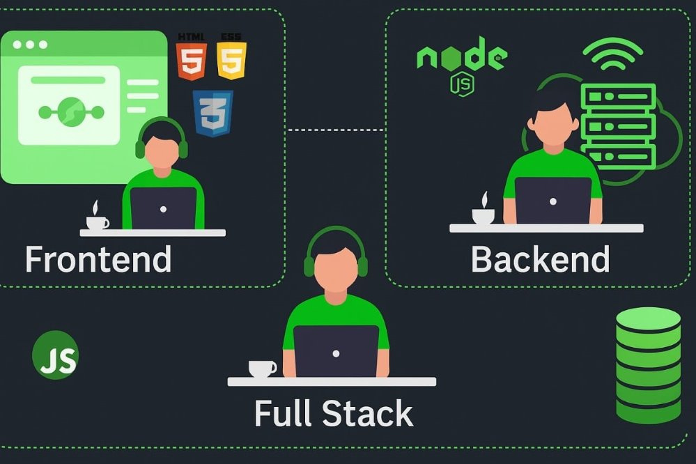

🛠Tech
Stack Used
GEEK VERSE
->MERN STACK
->AI USED : Open AI + Our OWN Model for Better accuracy and security is under developemnt​
-> + additional supporting tools and libraries

Slide 5
REVENUE
MODEL
FREE PLAN (BASIC ACCESS)
✅ Access tO A BASIC DASHBOARD WITH A SIMPLE PROGRESS TRACKER.
✅ LIMITED-TIME ACCESS TO THE AI MODEL FOR GENERAL GUIDANCE AND BASIC LEARNING TIPS.
✅ EXPLORE THE PLATFORM AND UNDERSTAND THE CORE FEATURES BEFORE UPGRADING.
PREMIUM PLAN (FULL ACCESS)
SUBSCRIPTION PERKS
🌟 UNLOCK FULL POTENTIAL: ENHANCED LEARNING PATHS, REAL-WORLD OPPORTUNITIES, AND A PORTFOLIO-READY SHOWCASE OF YOUR PROGRESS.
📄 AutOMATIC RESUME BUILDER POWERED BY AI — GENERATES A PROFESSIONAL, UP-TO-DATE RESUME BASED ON YOUR ACHIEVEMENTS, CERTIFICATES, AND SKILLS.
🏆 DEDICATED PERSONAL SPACE TO STORE AND ORGANIZE CERTIFICATES — NO MORE SEARCHING THROUGH FOLDERS!
🚀 PERSONALIZED AI RECOMMENDATIONS FOR HACKATHONS, COMPETITIONS, AND EVENTS THAT MATCH THE USER'S INTERESTS AND SKILL LEVEL.

Slide 6
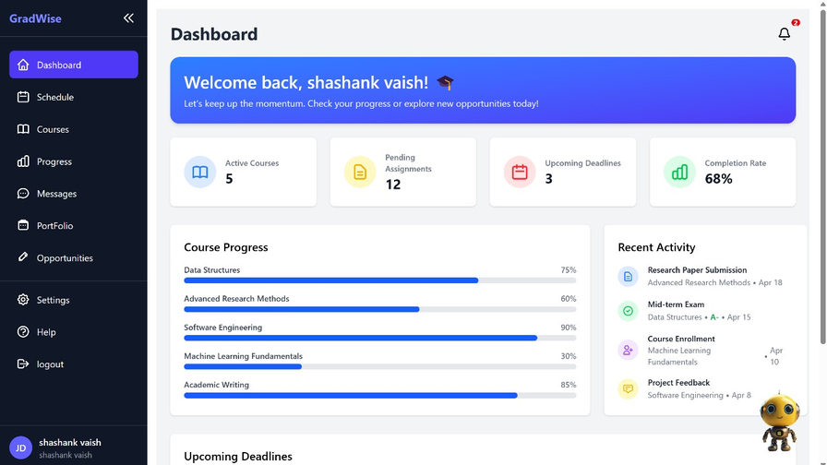
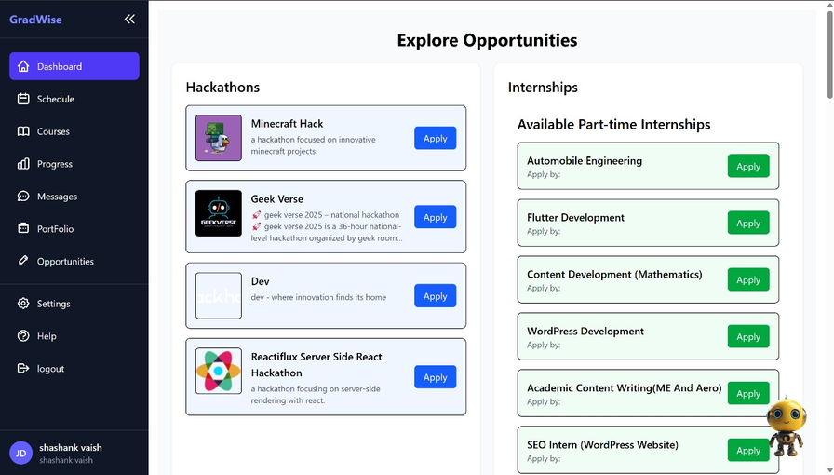
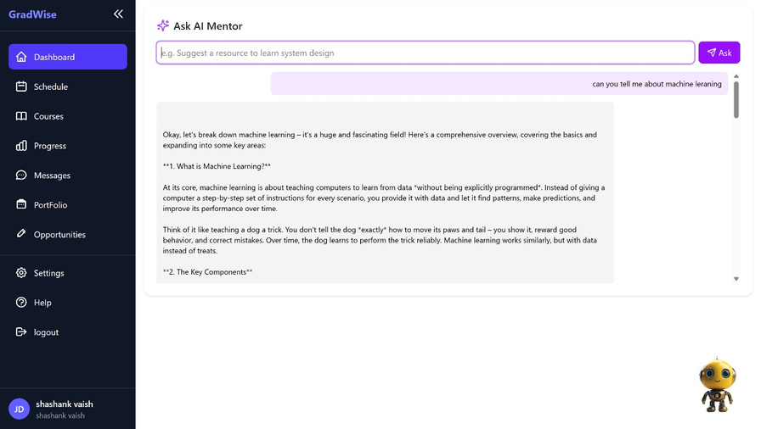
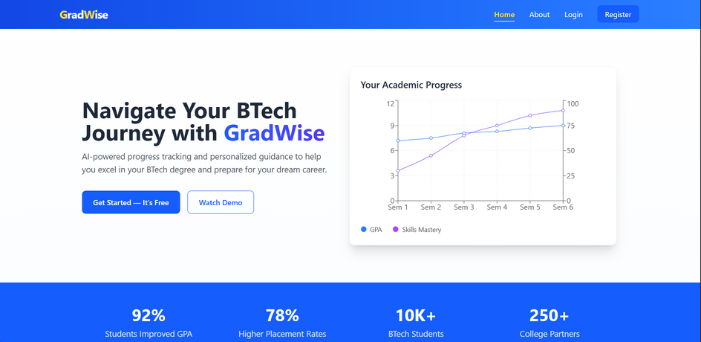
Conclusion
Summary
GEEK VERSE
🚀 GradWise simplifies the student journey by bringing courses, AI help, hackathons, internships, and scheduling—all in one place. With smart tracking and personalized recommendations, it helps students grow faster and smarter.
It’s not just a platform—it’s a launchpad for future-ready graduates.
Our Prototype Images:-
Team
Details
VAIBHAV KUMAR SINGH
VIHAAN KAUSHIK
SHASHANK VAISH

